Slide 1
Makey makey
Let your students invent and be creative!

Slide 2
YouTube Video

Slide 3
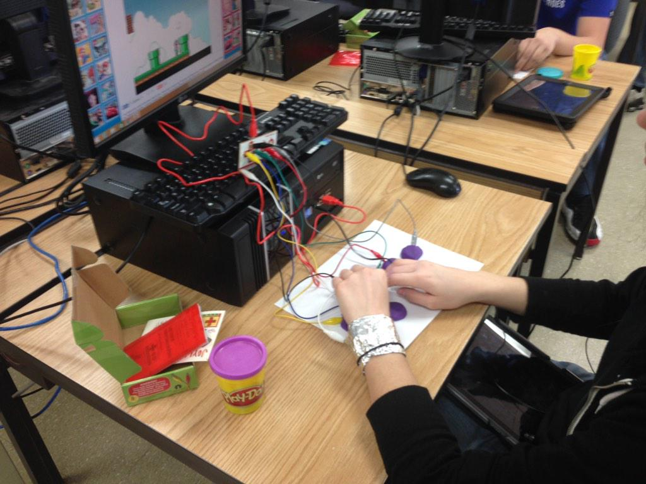
Students will need
Computer/laptop
Play-doh
Tin foil
Makey makey kit
Piece of paper

Slide 4
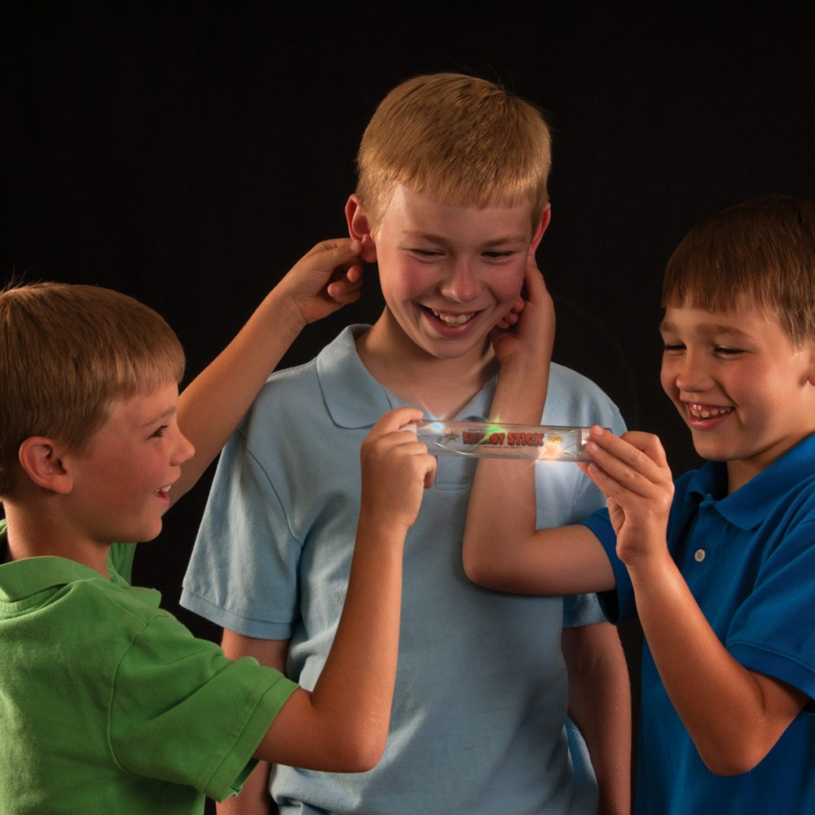
Demonstrate conductor
demonstrate how conductivity can travel from person to person—circuit has to complete

Slide 5
Introduction lesson
Have students open up a digital game that can be played on the keyboard
Have them play the game a couple of times to become familiar with it
Ex: Let’s try pacman!
Now introduce the makey makey to students!

Slide 6
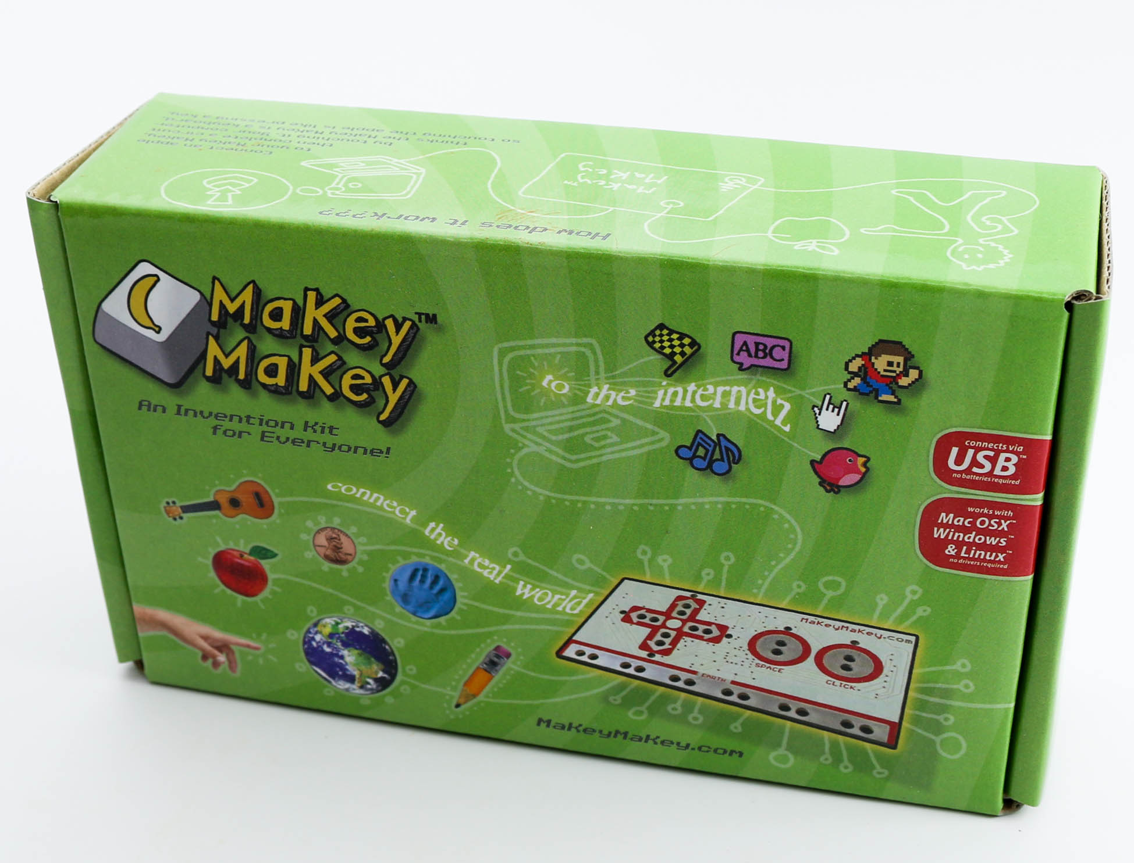
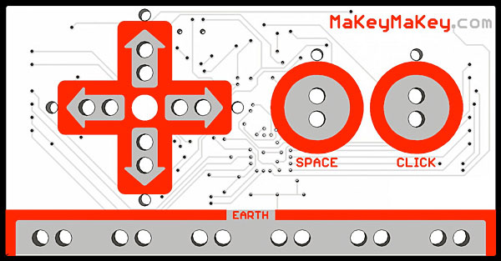
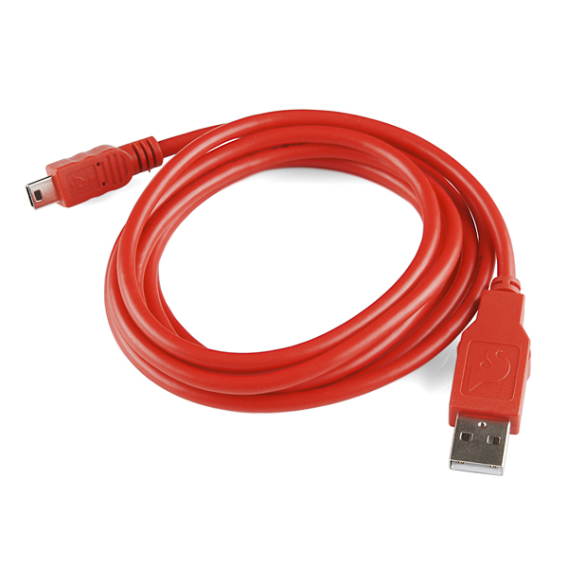
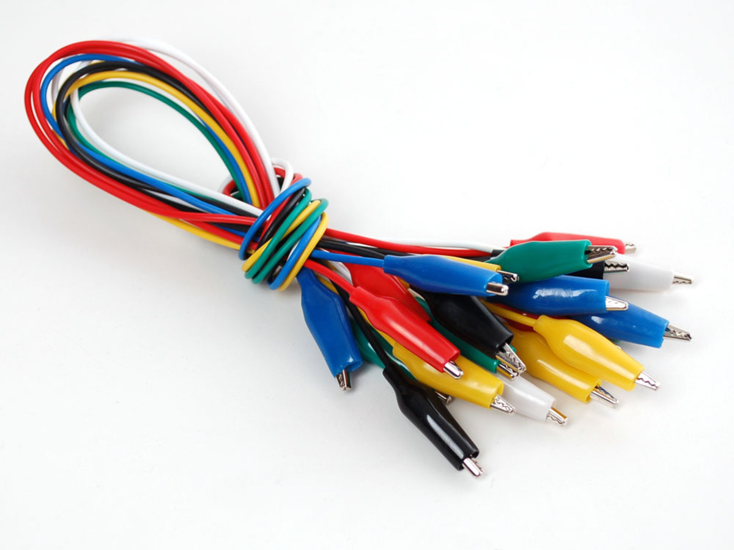
Makey makey kit
USB Cable
Makey Makey Board
7 Alligator Clips
6 Connector (Jump) Wires

Slide 7
Steps to connect
Have students:
Connect USB to computer
White clip used to ground to earth
Have students use foil to make a “bracelet” and this will be the ground
Connect other clips to arrows & space

Slide 8
Create controller
Layout piece of paper
Use play dough to make “controller”—need left, right, up, and down arrow. Make space key
Connect the alligator clips to the appropriate controller

Slide 9
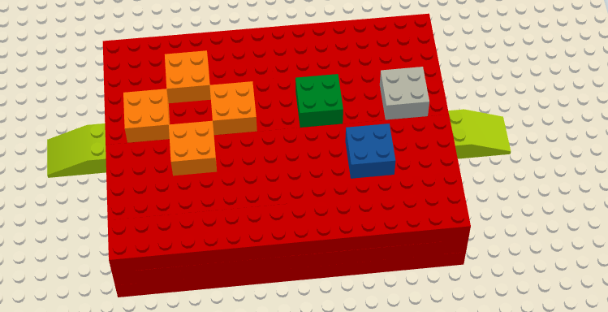
Other options for controllers

Slide 10
Have students try out their controller!
http://makeymakey.com/piano/
http://www.thepcmanwebsite.com/media/pacman_flash/

Slide 11
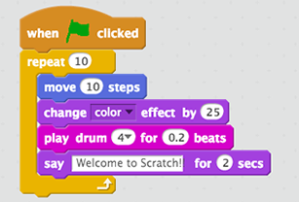
Introduce students to programming
Using a simple, easy to learn site like scratch (https://scratch.mit.edu/)
Introduce scratch
accounts are necessary to save and share
try your controller with example
https://vimeo.com/65583694

Slide 12
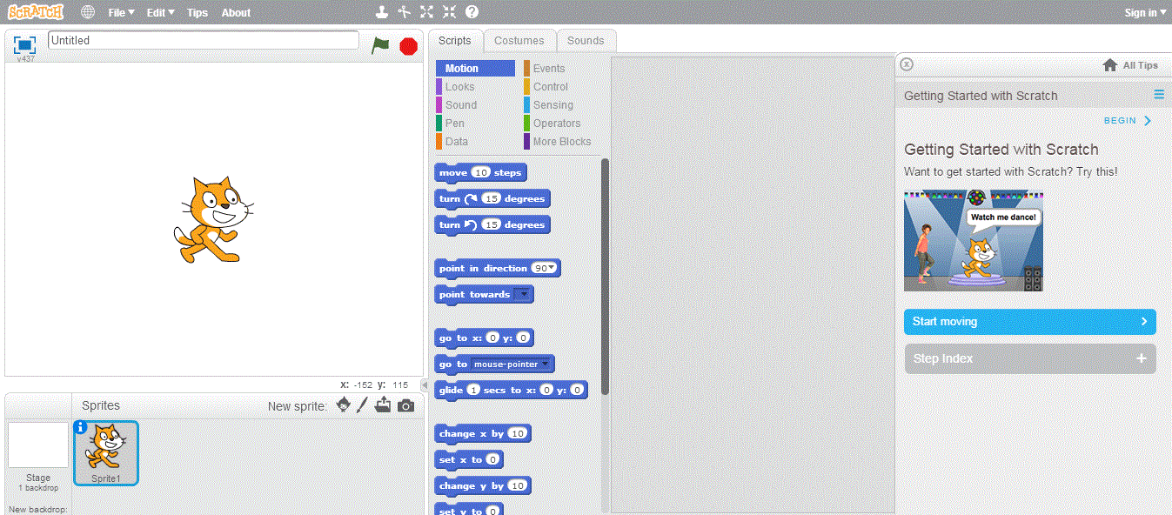
Create a simple scratch project

Slide 13
Students create!

Slide 14
Conductive Materials
Craft Materials for inventing
Pieces of Fruit
Lots of other foods—marshmallows, gummy candies, macaroni
Lines of graphite drawn on paper
Liquids
Plants with the wire in the soil and touching a leaf
Foil and other metal objects
People
Use your own imagination
Inflatable beach balls, paper plates, or cardboard boxes,
various types of soft and rigid foam
lego bricks
plastic storage boxes
stuffed animals and other toys
funny hats and other pieces of clothing, sheets of fabric, string, yarn, elastic, and paper.
Notes:
It's also important to have around some tools for cutting, like scissors and exacto knives, and ways to stick things together, like hot glue, superglue, various kinds of tape, and clips or clamps.

Slide 15
Resources for lesson
Makey makey quick start guide
Makey Makey project examples
Makey makey project guides
Scratch guides
Scratch online community
Scratch Ed grade levels, content, and curricular area
Purchase makey makey kit $49.95

